Slide 1
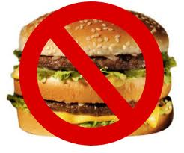
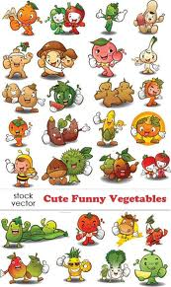
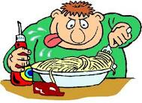
My favorite food
Zabluda Anna Aleksandrovna
English language
7 form

Slide 2
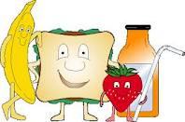
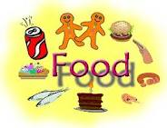
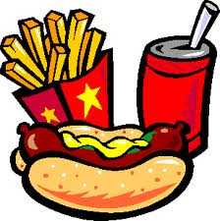
Sometimes life is so boring… And you think if eating more cripes, hamburgers, hot-dogs or ice-cream life will be better. But can you do it all the time? Can this tasty things be dangerous for your health? Let’s learn more about it!

Slide 3
What I know about my favorite food
Тематичні запитання:
Where is the land of hamburgers and hot-dogs?
Why my favorite pet don’t like cripes as much as I?
What should I eat if I want to be healthy?
Змістовні запитання:
How to cook my favorite cripes?
What are gmo means?
Are cripes healthy for me?
What kind of food are not only tasty but healthy?

Slide 4
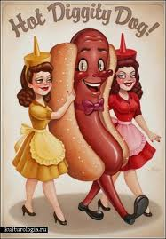
Let's learn more about food
Let's do this work together

